Slide 1
Stage 5: Getting Loopy

Slide 2
Objectives
Repeat actions initiated by the instructor
Translate a picture program into a live-action dance
Convert a series of multiple actions into a single loop

Slide 3
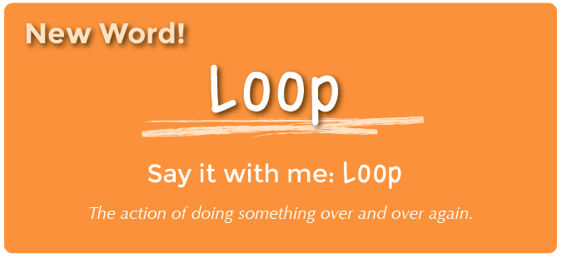
Vocabulary

Slide 4
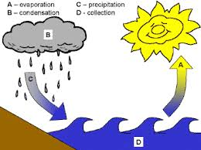
Loop

Slide 5
Example - Volunteer
Walk around the room once
Walk around the room again
Walk around the room again
Walk around the room again
Would it have been easier for me to just ask you to go around the room four times?
If I ask you to repeat an action any number of times it is called loop

Slide 6
Video
http://studio.code.org/s/course2/stage/5/puzzle/1

Slide 7
Dance Party
Sometimes, when you know that you will be doing something over and over, it is helpful to know how many times it needs to be done before you begin. That way, you can keep track of how many actions you have left as you go.
Example: If your mom wanted you to play her favorite song over and over, she wouldn’t say:
“Please play my song, play my song, play my song, play my song.”
She would likely say “Please play my song four times.”

Slide 8
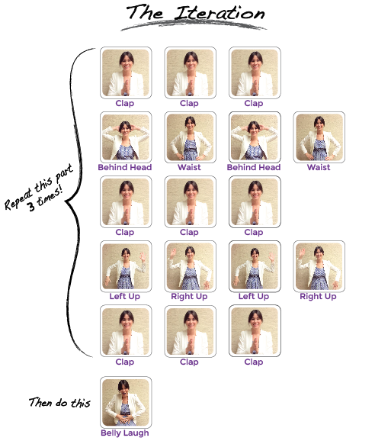

Slide 9
Loops
Can you find the loop in the instruction?
Can you find anything else in the dance that we could use for a loop?
Handout Getting Loopy Assessment

Slide 10
Computer Time
Login to computer
Open Mozilla Firefox
Type URL –
http://studio.code.org/sections/FEBRQV
Go to Stage 5, skip video answer one question
Stop at Stage 6: Maze Loops

